Slide 1


CatBoost
2020. 12. 04.

Slide 2
Kaggle 1st place Solutions with Light GBM
년도 | 대회 명 | Type | Winning Algorithm
2019 | Energy Consumption | Single | Light GBM
2019 | 2019 Data Science Bowl | Single | Light GBM
2019 | Kaggle Days Meetup Porto 2019 | Single | Light GBM
2019 | LANL Earthquake Research competition | Single | Light GBM
2019 | IEEE-CIS Fraud Detection | Ensemble | LGBM, CatBoost, XGBoost
2018 | PLAsTiCC Astronomical Classification | Single | Light GBM
2018 | Home Credit Default Risk | Ensemble | Ensemble with Light GBM
2017 | Porto Seguro’s Safe Driver Prediction | Ensemble | Ensemble with Light GBM
2017 | Instacart Market Basket Analysis | Single | Light GBM
2017 | Toxic Comment Classification Challenge | Ensemble | Stacking with Light GBM
2017 | WSDM - KKBox's Music Recommendation Challenge | Ensemble | NN, Light GBM

Slide 3
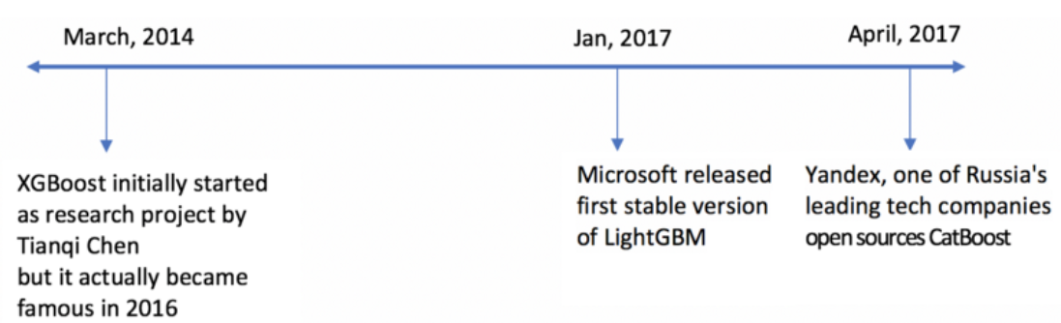
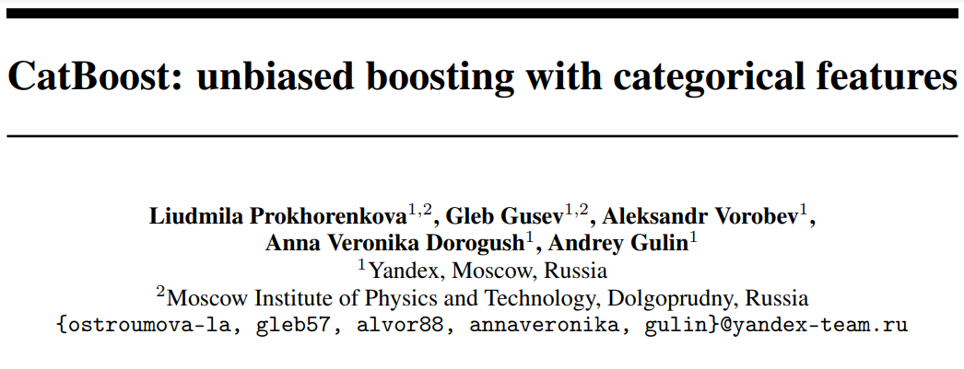
CatBoost?
Level-wise (same with XGBoost)
Target categorical data
Notes:
https://www.kdnuggets.com/2018/03/catboost-vs-light-gbm-vs-xgboost.html 코드 돌려보기

Slide 4
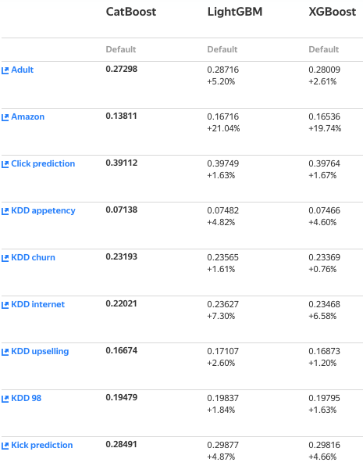
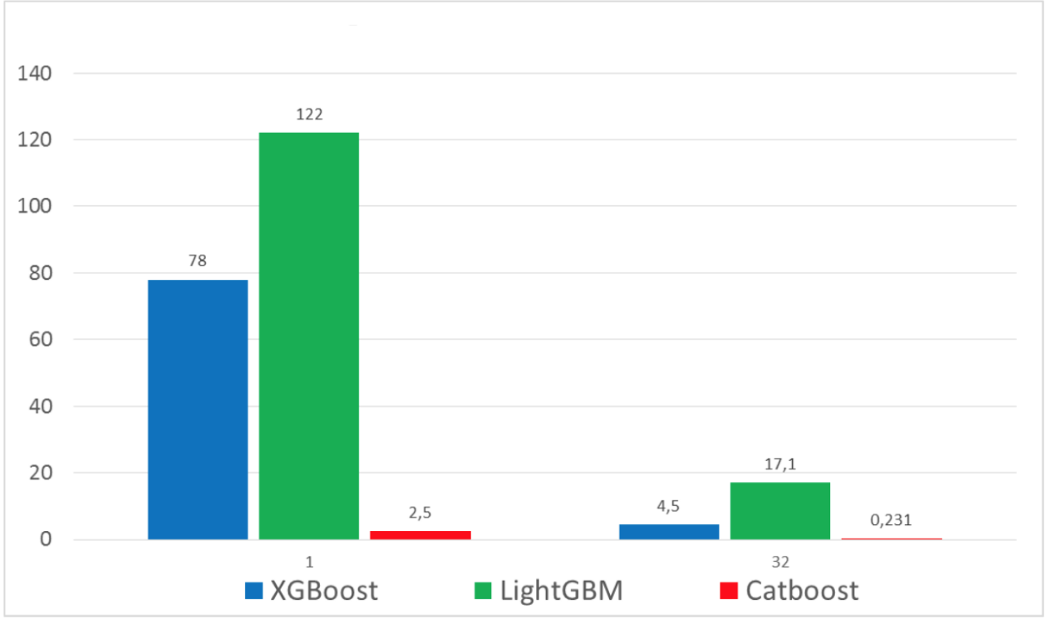
XgBoost vs LightGBM vs CatBoost
범주형 데이터에서 XGBoost, LightGBM보다 더 빠르고 우수한 결과
수치형 데이터에서는 LightGBM보다 느림

Slide 5
CatBoost
Encoding Categorical Features
1) Ordered Target Encoding (different from XGBoost)
Solve categorical data problem
Reduce data handling time
2) Feature Combination
What if there is a correlation between categorical variables?
Simply Encoding → correlation ignored, loss of data information
Greedy tree learning using combination
Boosting
Plain Boosting
Ordered Boosting

Slide 6
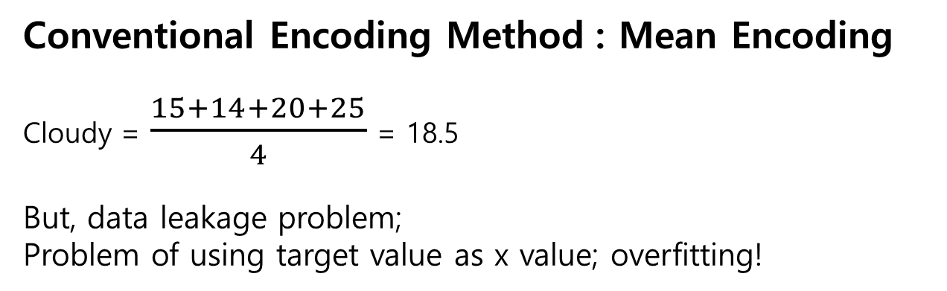
1. Encoding Categorical Features (1) Ordered Target Encoding
Feature 1 | Y
Sunny | 32
Cloudy | 15
Cloudy | 14
Mostly_cloudy | 10
Cloudy | 20
Cloudy | 25
Conventional Encoding Method : Mean Encoding
Cloudy = $\frac{15+14+20+25}{4}$ = 18.5
But, data leakage problem;
Problem of using target value as x value; overfitting!

Slide 7
1. Encoding Categorical Features (1) Ordered Target Encoding
Make ordered data
If there is no data order, artificially assign the order
Using random permutation
... or just use the order of existing data
Feature 1 | Y
Sunny | 32
Cloudy | 15
Cloudy | 14
Mostly_cloudy | 10
Cloudy | 20
Cloudy | 25
Time | Feature 1 | Y
Sun | Sunny | 32
Mon | Cloudy | 15
Tue | Cloudy | 14
Wed | Mostly_cloudy | 10
Thu | Cloudy | 20
Fri | Cloudy | 25

Slide 8
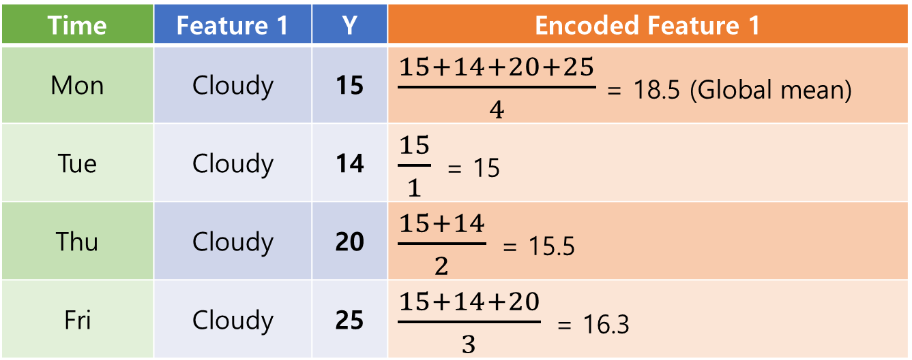
1. Encoding Categorical Features (1) Ordered Target Encoding
2. Encode each categorical value, only using previous data
Time | Feature 1 | Y | Encoded Feature 1
Mon | Cloudy | 15 | $\frac{15+14+20+25}{4}$ = 18.5 (Global mean)
Tue | Cloudy | 14 | $\frac{15}{1}$ = 15
Thu | Cloudy | 20 | $\frac{15+14}{2}$ = 15.5
Fri | Cloudy | 25 | $\frac{15+14+20}{3}$ = 16.3

Slide 9
1. Encoding Categorical Features (2) Feature Combination
What if there is a correlation between categorical variables?
(ex) User ID - Ad topic
Combines all categorical features already used for previous splits in the current tree
cat feature1
cat feature1
cat feature1
...
cat feature2
cat feature2
cat feature3
Combine cat feature 1 & 2
New cat feature A
ordered target encoding
Combine cat feature A & 3
New cat feature B
ordered target encoding

Slide 10
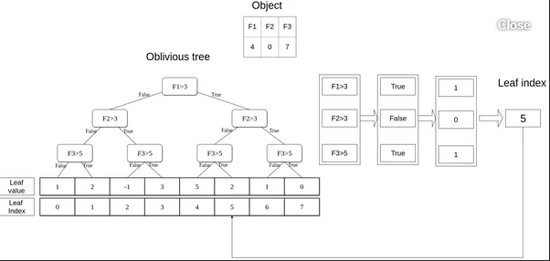
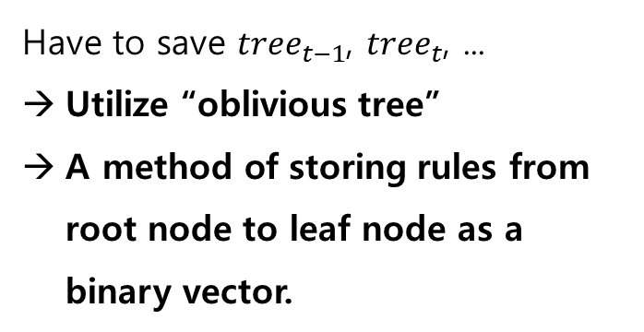
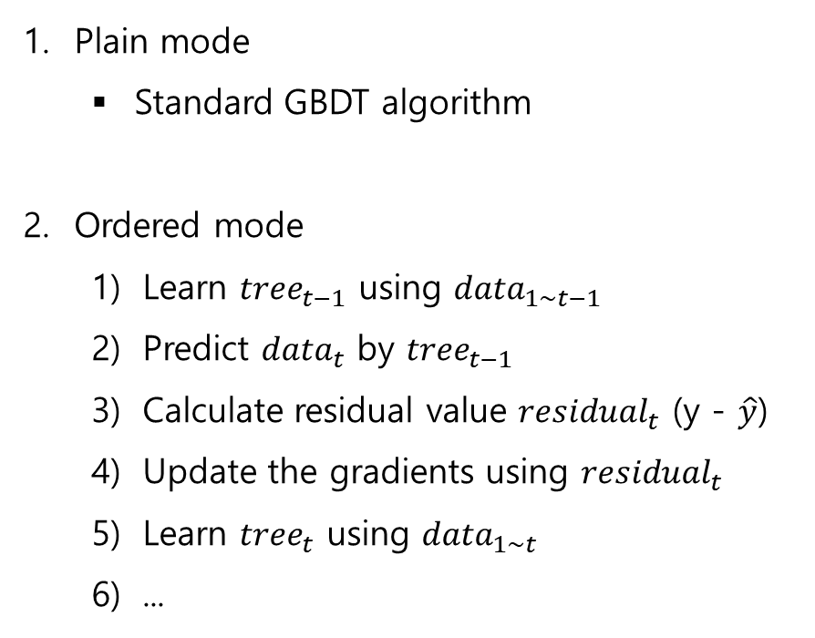
2. Ordered Boosting – Plain or Ordered
Plain mode
Standard GBDT algorithm
Ordered mode
Learn ${tree}_{t−1}$ using ${data}_{1\sim t−1}$
Predict ${data}_{t}$ by ${tree}_{t−1}$
Calculate residual value ${residual}_{t}$ (y - $\hat{y}$)
Update the gradients using ${residual}_{t}$
Learn ${tree}_{t}$ using ${data}_{1\sim t}$
...
Have to save ${tree}_{t−1}$, ${tree}_{t}$, ...
Utilize “oblivious tree”
A method of storing rules from root node to leaf node as a binary vector.

Slide 11
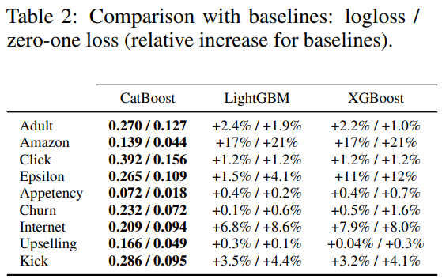
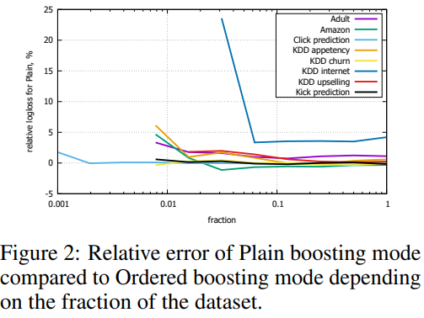
CatBoost Result
(Table 2) Result of Ordered mode, comparison with classic GBDT
(Figure 2) Relative error of Plain mode compared to Ordered mode
Ordered mode is particularly useful on small datasets

Slide 12
Current Trend...
모델 자체 개발이라기보다, 모델에 맞는 데이터 전처리 방법 고안
특히 범주형 데이터 전처리 집중
Sparse feature combination, Encoding, ...

